Slide 1

Statistical Methods:
Searches for New Physics
Christian Veelken
christian.veelken@cern.ch

Slide 2

Outline
Introduction
The decision whether to quote a signal significance
or an exclusion limit
Hypothesis tests
Test statistic
Sampling distribution
Decision rule
Computation of signal significance
Computation of exclusion limit
CL_{s} method
Christian Veelken Statistical Methods: Searches for New Physics 2

Slide 3
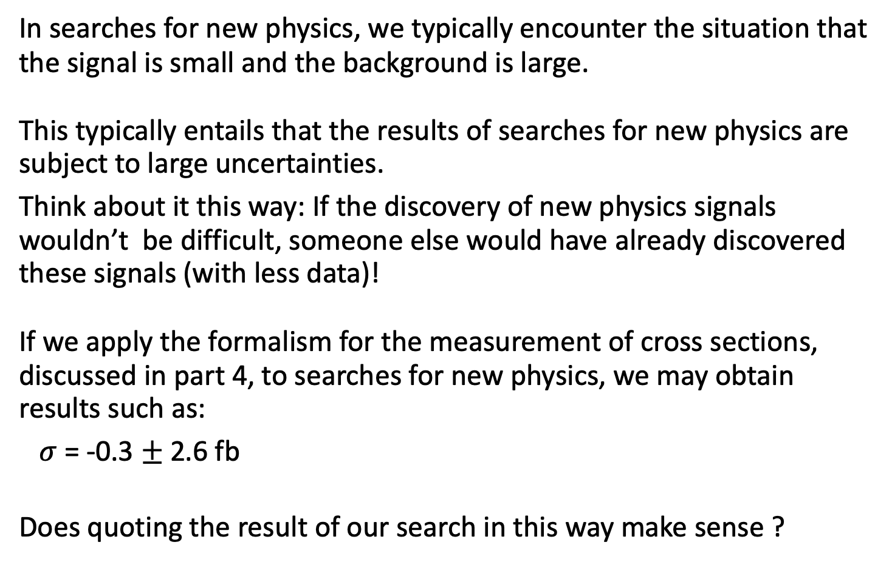
Introduction
In searches for new physics, we typically encounter the situation that the signal is small and the background is large.
This typically entails that the results of searches for new physics are subject to large uncertainties.
Think about it this way: If the discovery of new physics signals wouldn’t be difficult, someone else would have already discovered these signals (with less data)!
If we apply the formalism for the measurement of cross sections, discussed in part 4, to searches for new physics, we may obtain results such as:
$σ$ = -0.3 $±$ 2.6 fb
Does quoting the result of our search in this way make sense ?
“femtobarn”, unit for the smallest cross sections that we can measure at the LHC (femto = 10⁻¹⁵)
Christian Veelken Statistical Methods: Searches for New Physics 3

Slide 4
Introduction
In particular since we know that cross sections are positive [*] ?
In searches for new physics, we need a different way of quoting the results.
[*] Unless the new physics interferes with the Standard Model.
This is a special case that requires a different approach to the analysis, which I will not discuss here.
Christian Veelken Statistical Methods: Searches for New Physics 4

Slide 5
Quoting Results of Searches
Do we see evidence for the presence of a signal in the data ?
Yes
No
Quote upper limit on cross section
(exclusion limit)
Quote significance of signal
Christian Veelken Statistical Methods: Searches for New Physics 5

Slide 6
Hypothesis Tests
The computation of signal significance and of exclusion limits are special cases of statistical hypothesis tests.
The task of a statistical hypothesis test is to make a decision between two hypothesis, the null hypothesis (H₀) and the alternate hypothesis (H₁).
In the special case of computing signal significances and exclusion limits, we wish to prove that H₁ is true.
We prove H₁ by rejecting H₀, which we do when the observed data are significantly unlikely to occur in case H₀ is true.
N.B.: If the data is consistent with H₀, than only a weak conclusion can be made, namely that the observed data provides no strong evidence against H₀. The decision about H₁ stays undecided in this case.
Christian Veelken Statistical Methods: Searches for New Physics 6

Slide 7

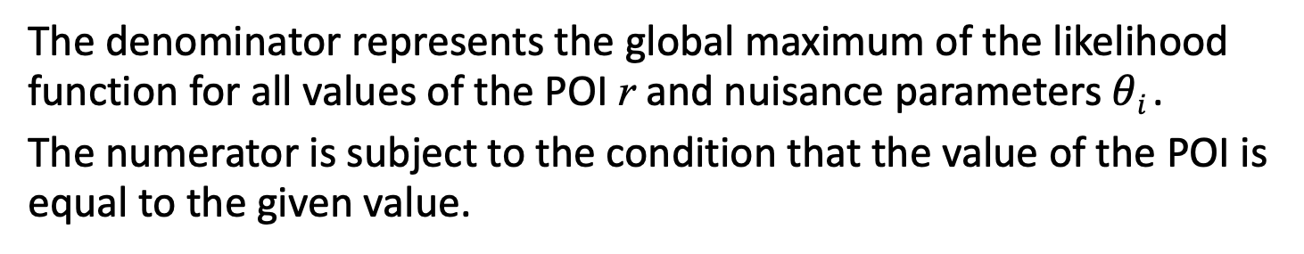
Test Statistic
The level of agreement of the data with H₀ and H₁ is checked using a test statistic, denoted by the symbol q.
We need to choose the test statistic such that the values of q that we obtain provide discriminating power between H₀ and H₁.
For the purpose of computing signal significances and exclusion limits, the test statistic is chosen to be the likelihood ratio
This ratio has a value between 0 and 1, as L $≥$ 0 and
the numerator is less than or equal to the denominator.
with
and
The denominator represents the global maximum of the likelihood function for all values of the POI r and nuisance parameters $θi$ .
The numerator is subject to the condition that the value of the POI is equal to the given value.
Christian Veelken Statistical Methods: Searches for New Physics 7

Slide 8
Test Statistic
If the null hypothesis is true, the condition that is applied in the numerator should not significantly reduce the likelihood value with respect to the denominator, i.e. the likelihood ratio should be close to unity and the value of the test statistic q_{r} should be close to zero.
N.B.: The motivation for choosing the likelihood ratio
for the test statistic is the Newman-Pearson lemma, which states that the likelihood ratio provides the optimal discriminating power
(if certain conditions are fulfilled).
https://en.wikipedia.org/wiki/Neyman-Pearson_lemma
Christian Veelken Statistical Methods: Searches for New Physics 8

Slide 9
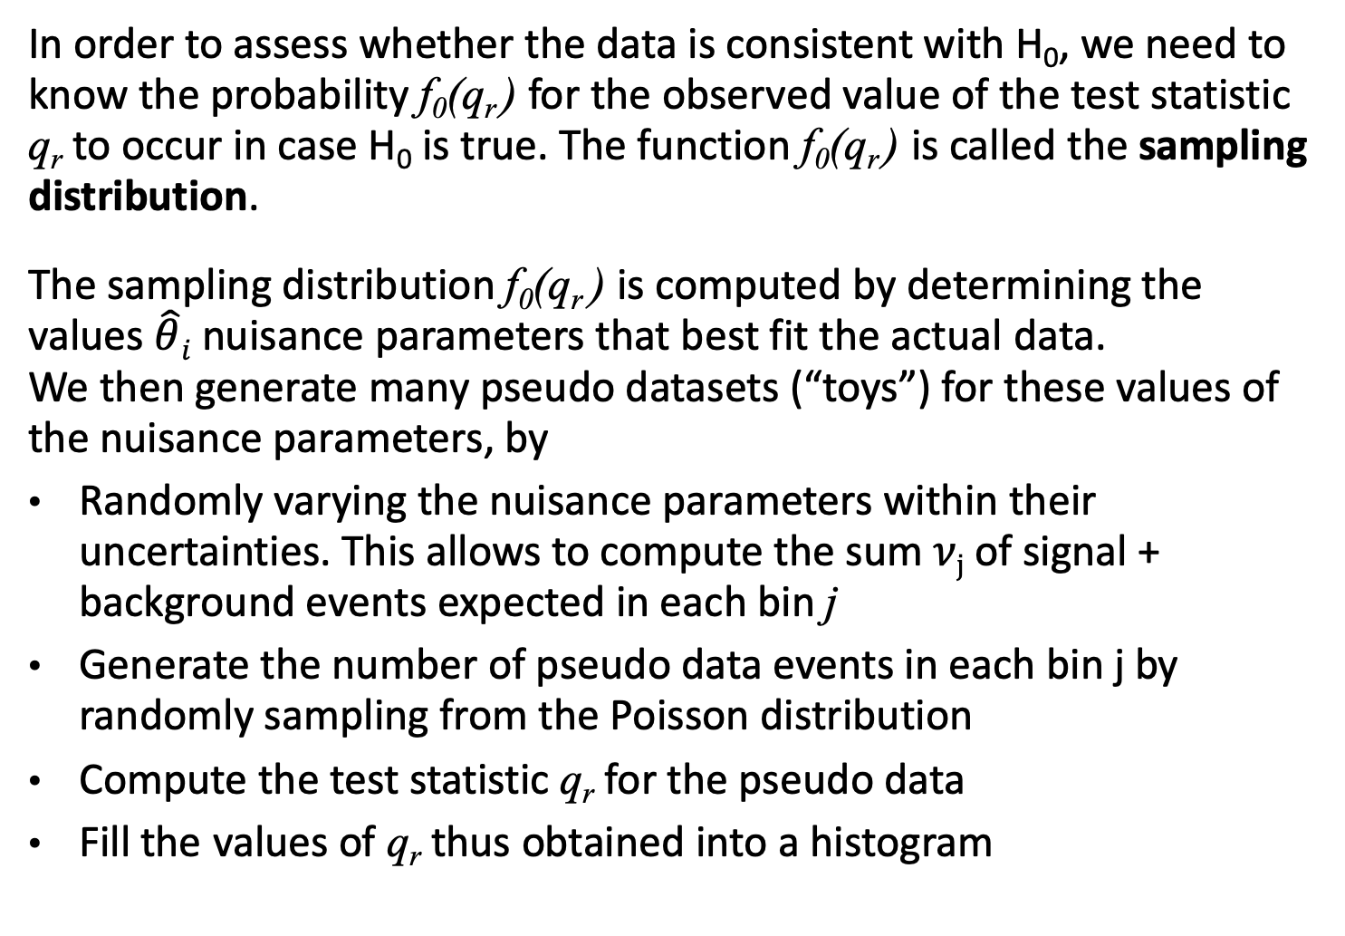
Sampling Distribution
In order to assess whether the data is consistent with H₀, we need to know the probability f₀(q_{r} ) for the observed value of the test statistic q_{r} to occur in case H₀ is true. The function f₀(q_{r} ) is called the sampling distribution.
The sampling distribution f₀(q_{r} ) is computed by determining the values $\hat{θ}i$ nuisance parameters that best fit the actual data.
We then generate many pseudo datasets (“toys”) for these values of the nuisance parameters, by
Randomly varying the nuisance parameters within their uncertainties. This allows to compute the sum $νj$ of signal + background events expected in each bin j
Generate the number of pseudo data events in each bin j by randomly sampling from the Poisson distribution
Compute the test statistic q_{r} for the pseudo data
Fill the values of q_{r} thus obtained into a histogram
Christian Veelken Statistical Methods: Searches for New Physics 9

Slide 10
Sampling Distribution
N.B.: In the limit of an infinite number of signal (S) + background (B) events, the sampling distribution for the null hypothesis and for the alternate hypothesis can often found analytically, without the time-consuming computation of toys.
In case of a finite number of S+ B events, these analytic formulas represent approximations and are called asymptotic approximations, where asymptotic means “in the limit of a very large number of S + B events”.
https://en.wikipedia.org/wiki/Wilks'_theorem
http://inspirehep.net/record/860907
Christian Veelken Statistical Methods: Searches for New Physics 10

Slide 11
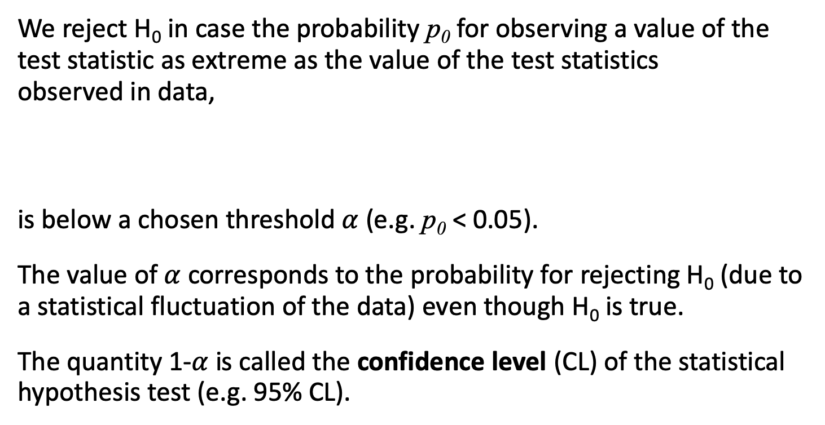
Decision Rule
We reject H₀ in case the probability p₀ for observing a value of the test statistic as extreme as the value of the test statistics
observed in data,
is below a chosen threshold $α$ (e.g. p₀ < 0.05).
The value of $α$ corresponds to the probability for rejecting H₀ (due to a statistical fluctuation of the data) even though H₀ is true.
The quantity 1-$α$ is called the confidence level (CL) of the statistical hypothesis test (e.g. 95% CL).
Christian Veelken Statistical Methods: Searches for New Physics 11

Slide 12
Computation of Signal Significance
When computing the significance for discovery of a signal for new physics, the null hypothesis is that there is no signal [*] and the alternate hypothesis is that the signal exists [**].
In case the data exhibits a significant excess of events over the background-only hypothesis, H₀ is rejected and H₁ accepted,
i.e. the presence of the signal for new physics is established.
The probability p₀ is called p-value (probability value) in the context of computing the signal significance.
[*] also called background-only hypothesis
[**] also called signal + background hypothesis
Christian Veelken Statistical Methods: Searches for New Physics 12

Slide 13
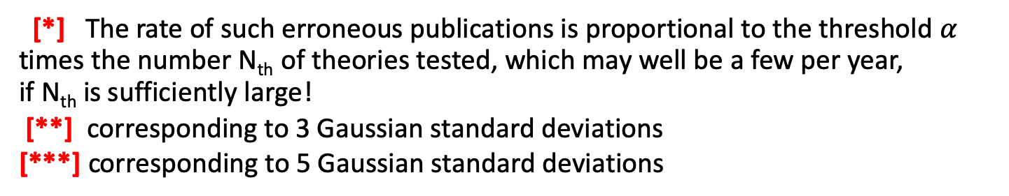
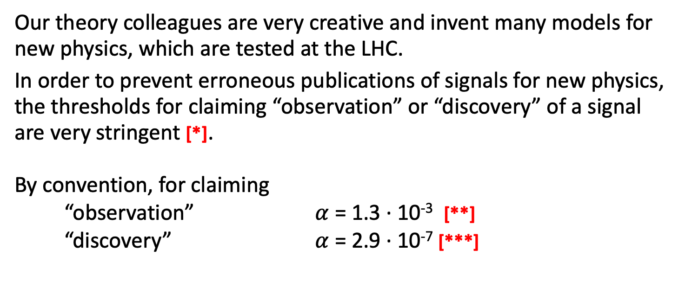
Computation of Signal Significance
Our theory colleagues are very creative and invent many models for new physics, which are tested at the LHC.
In order to prevent erroneous publications of signals for new physics,
the thresholds for claiming “observation” or “discovery” of a signal are very stringent [*].
By convention, for claiming
“observation” $α$ = 1.3 ∙ 10⁻³ [**]
“discovery” $α$ = 2.9 ∙ 10⁻⁷ [***]
[*] The rate of such erroneous publications is proportional to the threshold $α$ times the number N_{th} of theories tested, which may well be a few per year,
if N_{th} is sufficiently large!
[**] corresponding to 3 Gaussian standard deviations
[***] corresponding to 5 Gaussian standard deviations
Christian Veelken Statistical Methods: Searches for New Physics 13

Slide 14
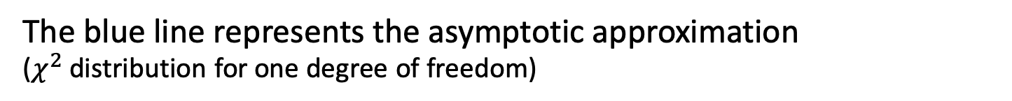
Computation of Signal Significance
Sampling distribution
f₀(q₀)
Observed value
The blue line represents the asymptotic approximation
($χ^{2}$ distribution for one degree of freedom)
https://cds.cern.ch/record/1379837/files/NOTE2011_005.pdf
Christian Veelken Statistical Methods: Searches for New Physics 14

Slide 15
Example for Signal Significance
Building evidence for the Higgs boson
(CERN seminar in December 2011)
https://cms-docdb.cern.ch/cgi-bin/PublicDocDB/RetrieveFile?docid=5709
Christian Veelken Statistical Methods: Searches for New Physics 15

Slide 16
Computation of Exclusion Limit
When computing exclusion limits, the null hypothesis is that there exists a signal with a large cross section and the alternate hypothesis is that the signal either does not exists or its cross section is small [*].
In case the data exhibits no significant excess of events over the null hypothesis, H₀ is rejected and H₁ accepted, i.e. the presence of a signal with a large cross section is excluded.
[*] Note that when computing exclusion limits, the signal + background hypothesis is the null hypothesis and the background-only hypothesis is the alternate hypothesis, i.e. their roles are inverted compared to the computation of the signal significance
Christian Veelken Statistical Methods: Searches for New Physics 16

Slide 17
CL_{S} Method
A special feature of the computation of exclusion limits is that the decision whether or not to reject H₀ is not based on the probability p₀ for the null hypothesis, but on the quantity
where
f₁(q_{r} ) denotes the sampling distribution computed for the case that the alternate hypothesis H₁ is true
and
The motivation for using the quantity CL_{s} for the decision rule is not to use downward fluctuations of the background as evidence against the signal.
The signal is excluded at “95% confidence level” if CL_{s} < 0.05,
which means that the probability for erroneously excluding a signal that does exist is 5%.
Christian Veelken Statistical Methods: Searches for New Physics 17

Slide 18
Computation of Exclusion Limit
Sampling distribution
f₀(q_{r})
f₁(q_{r})
CL_{s+b}
CL_{b}
q_{r}
https://cds.cern.ch/record/1379837/files/NOTE2011_005.pdf
Christian Veelken Statistical Methods: Searches for New Physics 18

Slide 19
Example for Exclusion Limit
Exclusion limits on theory (“minimal supersymmetric Standard Model”) that predicts the existence of additional Higgs bosons besides the Standard Model Higgs boson of mass 125 GeV discovered at the LHC
http://cds.cern.ch/record/2231507
Christian Veelken Statistical Methods: Searches for New Physics 19

